Slide 1
Software Development Tools
COMP220
Seb Coope
Eclipse and Ant
These slides are mainly based on “Java Development with Eclipse” – D.Gallardo et al., Manning Publications., 2003

Slide 2
Eclipse and ANT
We know that Eclipse is a good IDE for Java projects
  user friendly tool for writing and compiling Java code – the most obvious part of software development
It also has JUnit as a plug-in
  a standard tool for unit testing
But many more build steps are necessary to deliver a finished product:
  compiling,
  running programs (e.g. for testing purposes)
  documenting,
  packaging, and
  deploying the software.
You know that this can be automated by Ant
  a good independent and de facto standard build tool, and
Eclipse has Ant as one more plug-in
Our last goal in these lectures is to show how Ant works in the framework of Eclipse

Slide 3
Eclipse and ANT: Main Tasks
To see how Ant works from inside of Eclipse we should be able to
  create the build directory structure
  separate the source and build directories
    either while creating a new project,
    or in an existing project where these were not separated yet,
  import an existing project
    either as an Eclipse originated project (studied earlier)
    or as an independent Ant originated project
  create and edit an Ant build XML file
  use default Ant editor
  run Ant from inside of Eclipse
  This will show some advantages of integrating Ant with Eclipse
  First we consider
  the simplest of these tasks in the simplest form

Slide 4
Creating the build directory structure
Recall that the first step in formalizing the build process is to clearly separate files as
  source files,
  other resources,
  temporary files (compiled files), and
  deliverables (JAR, etc).
How to do this in Eclipse?
Note that in Eclipse this is more than just creating new directories.

Slide 5
Separating the source and build directories in a new project
In the case of a new project Eclipse simply suggests two alternatives:
  either choose
    “Create separate folders for sources and class files”
    This way we have already created the project Hello
    with src the directory for source files and
    with the default bin directory for compiled classes.
  or, alternatively, choose
  “Use project folder as root for sources and class files”
  Then sources and compiled class files will be in the same root directory whose name is the name of the project.
    It is this way we created the project
  Proj-Joint-Source-Classes

Slide 6
Separating the source and build directories in a new project
The case of new project with the default src and bin directories is quite easy.
However, we will also consider below more complicated case when we need several different source and several corresponding different compiled classes directories.
6

Slide 7
Separating the source and build directories in an existing project
For already existing project
Proj-Joint-Source-Classes
containing e.g. Hello.java
such a separation is easily described as follows:

Slide 8
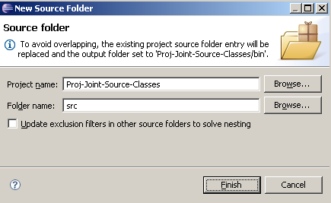
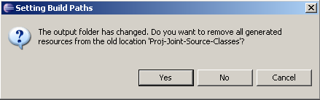
Separating the source and build directories in an existing project
In Java perspective,
right-click on the existing project name Proj-Joint-Source-Classes
select New->Source Folder
enter src as the folder name.
a separate output bin folder will be created by default.
Click Finish,
On the question concerning removing all generated resources (i.e., compiled Java classes), click Yes.

Slide 9
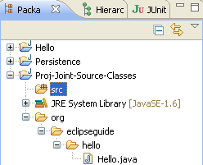
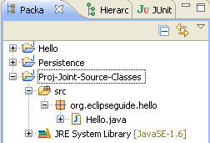
Separating the source and build directories in an existing project
  In the Package Explorer view,
    Drag-and-drop org folder (with its subfolders, etc.) onto the src folder.
  As the result, in the Package Explorer view
    we will see under src the source file under package org.ecliseguide.hello instead of nested directories.
    But we will not see the compiled class
  Check that in the ordinary Windows Explorer we will get files HelloWorld.java and HelloWorld.class separated by src and bin.

Slide 10
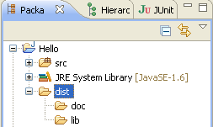
Separating the source and build directories in an existing project
  We can additionally, create folders
    Hello\dist\lib
    Hello\dist\doc
  for possible
    distributable files like HelloWorld.jar
    and documentation.
  Just right-click on dist directory and choose New > Folder

Slide 11
Creating a simple Ant example of build.xml
Like Ant alone, Eclipse also assumes
  the default build script’s name is build.xml
Eclipse automatically opens files with this name using the default Ant’s script editor:

Slide 12
Creating a simple Ant example of build.xml
  Right-click on an existing project, such as Hello project,
  Select New->File,
  Enter build.xml as the filename,
  Click Finish.
  The editor automatically opens build.xml.
  Press Ctrl-Space:
    The editor will immediately suggest you a template for a simple build file with two targets. (You can add more.)
12

Slide 13
Creating a simple Ant example of build.xml
Then type in, for example, the following:
  <?xml version="1.0"?>
  <project name="Hello" default="print message">
  <target name="print message">
  <echo message = "Hello from Ant!"/>
  </target>
  <target name="print another message"
  depends ="print message">
  <echo message = "Hello!"/>
  </target>
  </project>

Slide 14
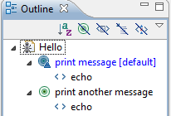
Creating a simple Ant example of build.xml
The Ant editor provides some basic conveniences, such as
  code-completion feature by pressing Ctrl-Space.
Between start and end tags, it shows available tags for sub-elements;
Inside of a start tag, it shows the allowed attributes for that tag.
It also provides
  syntax highlighting and
  an outline view.
14
Notes:
14

Slide 15
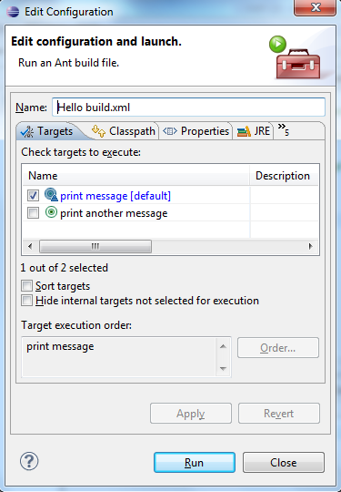
Running Ant from inside of Eclipse
To run build.xml, first
  save it.
Then right-click on build.xml in the Editor or in the Package Explorer
Select either
  Run as > 1 Ant Build, and see the next slide for the result, or, for more options,
  Run as > 2 Ant Build… (note `2’ and dots!)
In the opened dialog box
  choose Targets tab
  the default target is automatically selected,
  but you can choose any other target(s)
  click the Run button

Slide 16
Running Ant inside of Eclipse
This produces the following output in Eclipse’s Console view:
Buildfile: H:\eclipse\Hello\build.xml
print message:
[echo] Hello from Ant!
BUILD SUCCESSFUL
Total time: 161 milliseconds
with the underlined words clickable to show appropriate place in the build file

Slide 17

Running Ant inside of Eclipse
Note that selecting Run > 2 Ant Build… above gives us the possibility to choose any sequence of targets in the build file to call them in any order we want, like we did that in command line (and something more).
To re-run, click the button ;
Do not mix this button with the other similar button used for running Java and JUnit classes).
17
Notes:
(the green part, not the black triangle)

Slide 18
Default Ant Editor
The default editor for arbitrary (.xml or not) file (named differently from build.xml) is a
  simple text editor (not adapted to work with Ant build files).
But we want to use build files with arbitrary names (say, mybuild.xml):
  we can open it with Ant editor by right clicking this file and choosing the editor:
  Open with > Other... > Ant Editor
After that it will always be opened by this editor by double-clicking on it.
Notes:
OLD: Window > Preferences > Workbench > File Associations

Slide 19
Default Ant Editor
SELF-STUDY
We can also assign default Ant editor to any xml file:
Choose
Window > Preferences > General >
Editors > File Associations
Notes:
OLD: Window > Preferences > Workbench > File Associations

Slide 20
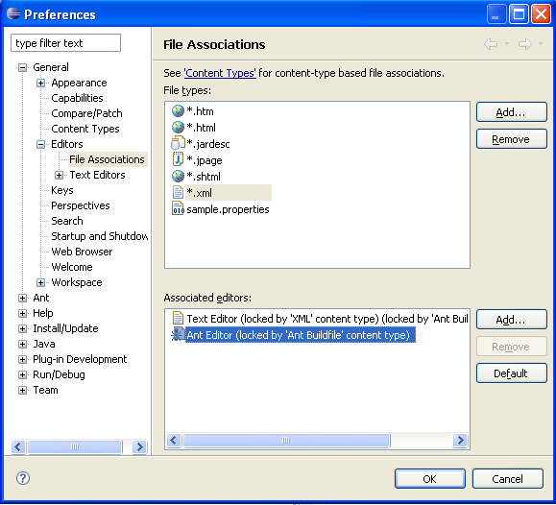
Default Ant Editor
SELF-STUDY

Slide 21
Eclipse and ANT:
Main Tasks Considered by Now
separating the source and build directories
  in a new project, and in
  in an existing project
(not completely considered yet) importing an existing project, whether it is
  an Eclipse project (quite easy! Considered earlier!) or
  an Ant project with two source directories
    for the ordinary source code and JUnit test cases and
    with two corresponding compiled classes directories
creating and editing a build xml file
setting and using default Ant editor
running Ant from inside of Eclipse (a simplest case)
Notes:
creating the build directory structure

Slide 22
Importing Existing Ant Project
into Eclipse
Formerly, when studying Ant, we were running mybuild.xml from the command line in various ways, in particular as
This means to run (call) the targets clean and test in this order. Of course, these targets will also call their dependencies…
Recall that this, in fact, involved (besides many other tasks)
  <junit> task for testing, and
  <junitreport> and <report> tasks to create html report on testing.
Now, we will be able to do all of this from Eclipse.
H:\Antbook\ch04>ant -f mybuild.xml clean test

Slide 23
Importing Existing Ant Project
into Eclipse
First, we want to import into the workspace of Eclipse the whole directory tree under H:\Antbook\ch04 (which you created yourselves in the Lab sessions).
Note that despite using the term import we will not use here the Import Wizard. Formally, this will look like creating a new project which will have a link to existing Ant Project.
Thus, importing does not necessarily mean that we will physically copy the whole directory tree into the workspace directory.
START IMPORTING (linking) by
  first creating a new Java project in Eclipse workspace, say LinkToCh04 and DO NOT CLICK FINISH for a while!
  STOP YOUR ACTIONS for some preliminary comments…
Notes:
One line omitted as inappropriate to the version of Eclipse 3.6.0:
choose option: Create project from existing source
(unique name without backslash between Antbook and Ch04)

Slide 24
Importing Existing Ant Project
into Eclipse
Additional steps are necessary because the contents of ch04 was not created as an Eclipse project.
Recall that we have in H:\Antbook\ch04
  two source subfolders src and test, and
  two corresponding output subfolders build\classes and build\test for compiled source Java files and JUnit test cases.
We should tell Eclipse about this even despite our Ant build file mybuild.xml already “knows” about this separation and correspondence between source and output directories.

Slide 25
Importing Existing Ant Project
into Eclipse
The point of this duplication of information for Eclipse is that
  it compiles java files automatically (while we are editing the code), independently on any Ant build file, and
  puts the results by default in one joint directory bin whereas we want to compile into two different directories.
But how to do this coherently with mybuild.xml?
The following several slides demonstrate in detail how to assign some folders to be source and, respectively, output folders.
After that we can run mybuild.xml from Eclipse
Notes:
(as we needed this in H:\Antbook\ch04)
Even after that some red marks witness some errors because mybuild.xml uses <junit> task, and we did not tell yet to Eclipse on the path leading to JUnit JAR for the current project LinkToCh04.
Eclipse helps to correct these errors automatically, by a couple of clicks.

Slide 26
Importing with source folders corresponding to specific output folders
Now, we will see the above general instructions illustrated as slide show on the next slide.
BE CAREFUL!!!
Act slowly and consciously!
Notes:
In the following below actions
Do not confirm deleting/removing anything!!!
despite the system might suggest this

Slide 27
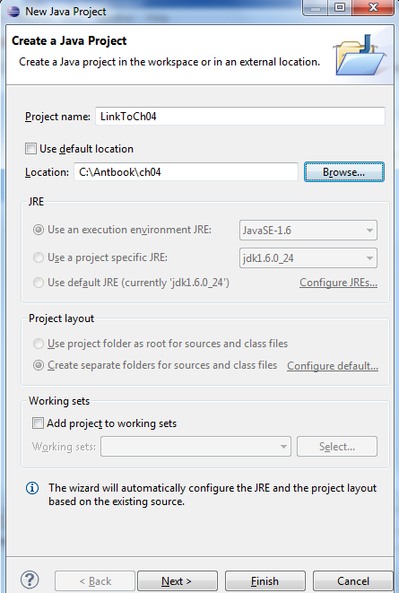
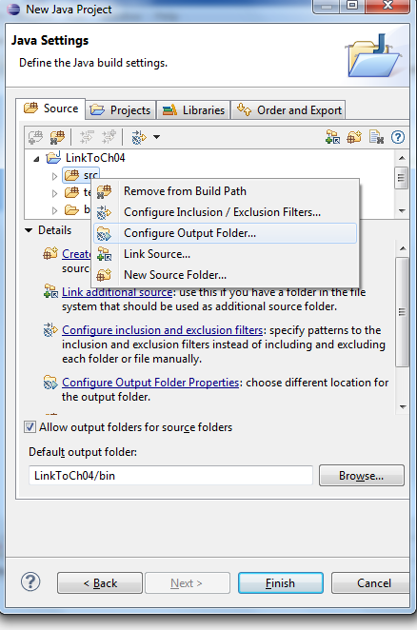
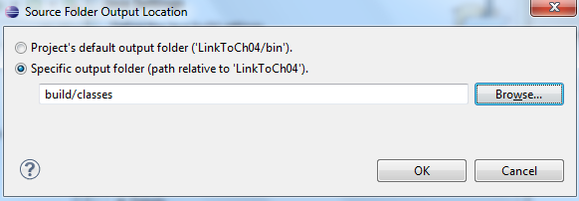
Createing project
LinkToCh04
from existing source without real moving it into current workspace directory
See the dynamics of actions in the slide show
Uncheck!
Rightclick (also for test)
Click Next.
Type bin to be default output folder
Allow different output folders
build/classes and build/test
for different source folders src and test
Do not agree to delete anything!!!
If forgotten something or needed to amend, do that via project’s Properties>Java Build Path>Source tab
Notes:
Do not agree to delete anything!!!
Typically clicking Finish
with Next omitted is sufficient .
Anyway,

Slide 28
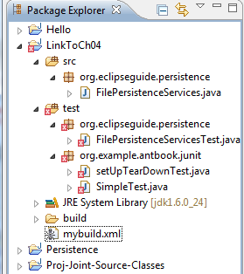
Importing with source folders
corresponding to specific output folders
You can see the result in Package Explorer and Project Explorer views.
This finishes the importing procedure, if there are no red error signs before JUnit test case names.
Otherwise, right-click on the project name LinkToCh04 and choose
Properties > Java Build Path > Libraries > Add Library > Junit > Next > Junit 4 > Finish > OK
We include the Junit library because our project contains Junit test cases.
If Junit 4 library (belonging to Eclipse) does not appear, see Slide 47 in 4. Eclipse and Java for an alternative solution.
Now all red error signs should disappear.
Notes:
, but some errors should be corrected which mean that
Eclipse needs some more information related with JUnit.

Slide 29
Running mybuild.xml from Eclipse
Recall that formerly, we have run mybuild.xml from the command line in various ways, in particular as
Now, after importing ch04 in Eclipse, let us run this from Eclipse as follows.
H:\Antbook\ch04>ant -f mybuild.xml clean test

Slide 30
Running mybuild.xml from Eclipse
Run mybuild.xml in Eclipse by right clicking on mybuild.xml and choosing
Run as > 2 Ant Build…
(note “2” and the dots):
  In the dialog box for creating configuration that will run Ant build file
    choose Targets tab,
    remove tick from the default target (if any), and
    put ticks only on clean and test targets (in this order!)
    This imitates formerly considered command
  Click Apply, and Run.
  Wait till console view will show the result.
H:\Antbook\ch04>ant -f mybuild.xml clean test
Notes:
In Refresh tab
tick “Refresh resources upon completion” and
choose “The project containing the selected resource”.

Slide 31
Running mybuild.xml from Eclipse
To re-run Ant build file , click the button
Do not mix this button with the other similar button used for running Java and JUnit classes.
This will produce something similar to the following long output in Eclipse’s Console view
  with the yellow [echo] and warning messages and
  with the red failure messages:
Notes:
the green part, not the black triangle;

Slide 32
Running mybuild.xml from Eclipse
Buildfile: C:\Antbook\ch04\mybuild.xml
[echo] Building Testing Examples
clean:
[delete] Deleting directory C:\Antbook\ch04\build
init:
[mkdir] Created dir: C:\Antbook\ch04\build\classes
compile:
[javac] Compiling 1 source file to C:\Antbook\ch04\build\classes
test-init:
[mkdir] Created dir: C:\Antbook\ch04\build\test
[mkdir] Created dir: C:\Antbook\ch04\build\data
[mkdir] Created dir: C:\Antbook\ch04\build\reports
test-compile:
[javac] Compiling 3 source files to C:\Antbook\ch04\build\test
test:
[junit] Testsuite: org.eclipseguide.persistence.FilePersistenceServicesTest
[junit] Tests run: 5, Failures: 2, Errors: 0, Time elapsed: 0.093 sec
[junit] Testcase:
(Continued)

Slide 33
testWrite(org.eclipseguide.persistence.FilePersistenceServicesTest):FAILED
[junit] NOT WRITTEN???
[junit] junit.framework.AssertionFailedError: NOT WRITTEN???
[junit] at org.eclipseguide.persistence.FilePersistenceServicesTest.testWrite(Unknown Source)
[junit] at org.eclipse.ant.internal.launching.remote.EclipseDefaultExecutor.executeTargets(EclipseDefaultExecutor.java:32)
[junit] at org.eclipse.ant.internal.launching.remote.InternalAntRunner.run(InternalAntRunner.java:424)
[junit] at org.eclipse.ant.internal.launching.remote.InternalAntRunner.main(InternalAntRunner.java:138)
[junit] Testcase: testRead(org.eclipseguide.persistence.FilePersistenceServicesTest):FAILED
[junit] expected:<[One, Two, Three]> but was:<null>
[junit] junit.framework.AssertionFailedError: expected:<[One, Two, Three]> but was:<null>
(Continued)
33

Slide 34
[junit] at org.eclipseguide.persistence.FilePersistenceServicesTest.testRead(Unknown Source)
[junit] at org.eclipse.ant.internal.launching.remote.EclipseDefaultExecutor.executeTargets(EclipseDefaultExecutor.java:32)
[junit] at org.eclipse.ant.internal.launching.remote.InternalAntRunner.run(InternalAntRunner.java:424)
[junit] at org.eclipse.ant.internal.launching.remote.InternalAntRunner.main(InternalAntRunner.java:138)
[junit] Test org.eclipseguide.persistence.FilePersistenceServicesTest FAILED
[junit] Testsuite: org.example.antbook.junit.SimpleTest
[junit] Tests run: 1, Failures: 0, Errors: 0, Time elapsed: 0.012 sec
[junit] Testsuite: org.example.antbook.junit.setUpTearDownTest
[junit] Tests run: 2, Failures: 0, Errors: 0, Time elapsed: 0.01 sec
34
(Continued)

Slide 35
[junit] ------------- Standard Output ---------------
[junit] setUp sets up a fixture
[junit] testA runs
[junit] tearDown releases fixture
[junit] setUp sets up a fixture
[junit] testB runs
[junit] tearDown releases fixture
[junit] ------------- ---------------- ---------------
[junitreport] Processing C:\Antbook\ch04\build\data\TESTS-TestSuites.xml to C:\Users\sazonov\AppData\Local\Temp\null534410474
[junitreport] Loading stylesheet jar:file:/C:/JAVA/eclipse/plugins/org.apache.ant_1.8.2.v20110505-1300/lib/ant-junit.jar!/org/apache/tools/ant/taskdefs/optional/junit/xsl/junit-frames.xsl
[junitreport] Transform time: 612ms
[junitreport] Deleting: C:\Users\sazonov\AppData\Local\Temp\null534410474
BUILD FAILED
C:\Antbook\ch04\mybuild.xml:255: Tests failed. Check log and/or reports.
Total time: 3 seconds
(The End)
35

Slide 36
Running mybuild.xml from Eclipse
Note that clicking on underlined file, target and task names in the console view also results in Ant attempting to take you to the appropriate place in appropriate file, opening it in appropriate editor.
The current version of Eclipse (unlike earlier ones) does not allow to see the contents of the directories for compiled files under the build directory in Project Explorer or Package Explorer view.
If the other subdirectories of build (data, reports) are invisible, then refreshing the Package Explorer can help:
Right-click -> Refresh
Thus, look at HTML report index.html created by juntreport task in build\reports in Eclipse Package Explorer or in the directory H:\Antbook\Ch04\build\reports by the ordinary Windows Explorer .
  Open (double click) index.html by Eclipse internal viewer of HTML files.
Notes:
by the Internet Explorer or just
or (in some specific cases) even in the related source Java file
, with the cursor on the line where the error occurred

Slide 37
Conclusion:
Importing an Existing Ant Project in Eclipse
Now we known how to
  separate the source and build directories in a new project in Eclipse,
  separate the source and build directories in an existing project in Eclipse,
  import existing Eclipse project into Eclipse workspace.
  import existing Ant project into Eclipse workspace with preserving it physically in the old directory and with preserving separation between source and build directories,
  work with the default Ant editor and how to make it default editor for arbitrary xml files,
  run build file from Eclipse.

Slide 38
Describing essential steps, advantages, and peculiarities of creating and running an Ant build file in Eclipse
Because it is difficult to automate software build processes using a GUI, they are usually designed to be run at a command prompt.
One additional benefit of using an external, completely independent build process like Ant is that it can free developers to use the development environment (like Eclipse or anything else) of their choice.
Forcing developers – especially the most experienced ones – to abandon the tools they've mastered can be detrimental to productivity.
Thus, Eclipse is only a free (but good) choice.

Slide 39
Describing essential steps, advantages, and peculiarities of creating and running an Ant build file in Eclipse
Eclipse automatically keeps the compiled class files up to date as we make changes to the Java source files,
  but for reliability and consistency, it is much better to automate the process using a build tool like Ant.
On the other hand, it is very convenient that Eclipse is closely integrated with Ant and
  can invoke it (just by mouse click) with choosing the tags to run and their order as desired.

Slide 40
Describing essential steps, advantages, and peculiarities of creating and running an Ant build file in Eclipse
There are some advantages of running the build from Eclipse because of the way Ant and Eclipse are integrated.
Eclipse is quite convenient tool for creating or reorganizing the build directory structure needed for the build process via Ant.

Slide 41
Describing essential steps, advantages, and peculiarities of creating and running an Ant build file in Eclipse
Eclipse assumes the default build script's name build.xml and automatically opens files with this name using the Ant script editor.
The Ant editor of Eclipse provides some basic convenience for creating build file, such as
  syntax highlighting and an outline view
  a code completion feature (invoked by Ctrl-Space)
    Between start and end tags, it shows available tasks for sub-elements
    inside of a start tag, it shows the valid attributes for that tag

Slide 42
Describing essential steps, advantages, and peculiarities of creating and running an Ant build file in Eclipse
Unlike running Ant from the command line, the Console View of Eclipse shows different types of messages in different colours (blue Ant's status messages, yellow echo and warning messages, and red error messages).
The benefit of Eclipse is that it alleviates debugging the build
  by the syntax highlighting and
  by clicking on red signs in the margin to go to the error;
  clicking on any target or task names in the console also will take you to the corresponding code in the build file)
Notes:
Especially convenient is that clicking on the compile error (appearing in the build process) takes you to the source file where the problem occurred.

Slide 43
SELF-STUDY
The need for an official build process
Although programming – writing and compiling code – is the most obvious part of software development, it is by no means the only part.
Testing is important too, as you’ve seen.
But many more steps are necessary to deliver a finished product:
  documenting,
  packaging, and
  deploying the software you develop.
Performing these steps by hand is tedious, repetitious, and error-prone.
This is a task begging to be automated.

Slide 44
SELF-STUDY
The need for an official build process
One of the main purposes for a separate build process is reproducibility.
Reducing human intervention decreases likelihood of error in the build process.
Because it is difficult to automate processes using GUI, build procedures are usually designed to be run at a command prompt.
One additional benefit of using an external, independent build process is that it can free developers to use the development environment of their choice – be that Eclipse or anything else.
We already know that Ant is such a good independent build tool.
Although Ant is really independent, we need both a good editor and IDE which would help creating and running both Java code and Ant build files.
Since Ant is integrated with Eclipse, build process can be run both inside Eclipse and outside at the command prompt.
Thus, the official build process, run at the command prompt, can be completely independent of Eclipse or any other development environment.

Slide 45
CONCLUSION
We finished our module “Software Development Tools”.
Now you know
  the main ideas of eXtreme Programming
  considerable part of Ant as a build tool
  beginnings of JUnit as testing tool and how it works from Ant
  how to use Eclipse for developing Java projects and how JUnit and Ant are working from Eclipse.
Start using this new tools in your everyday programming practice in Java to get all the benefits from this course.
Of course, you will need to study more on these tools, but you have already a good start.

